Slide 1
Electronics
Batteries
LabRat Scientific
© 2018

Slide 2
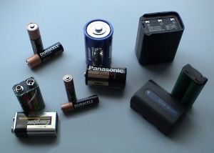
Battery Basics
A battery utilizes and a chemical reaction that liberates electrons
One end of the battery has too few electrons (the positive pole) and the other end has too many electrons (the negative pole)
Electrons migrate towards the pole with fewer electrons – In essence, the electrons are trying to fill the void…
Batteries produce a Direct Current (DC) voltage
Some batteries are rechargeable (secondary cells)
Batteries have limited capacity, which is measured in Amp-Hrs

Slide 3
Battery Basics
It is common practice for a single “cell” to be referred to as a battery, but this is not accurate
A battery is actually a collection cells

Slide 4
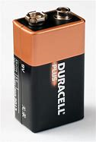
Typical Household Batteries
Size: AAA
1.5 Volts
Size: AA
1.5 Volts
Size: C
1.5 Volts
Size: D
1.5 Volts
Size: Transistor
9.0 Volts
Size: Lantern
6.0 Volts

Slide 5
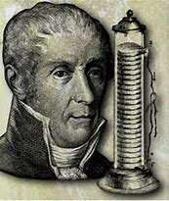
Unit of Electrical Potential
The unit of electrical potential is known as the VOLT
The VOLT is named in honor of the Italian physicist Alessandro Volta who studied electric potential generated by combining dissimilar metals in the early 1800’s
Alessandro Volta
(1745 – 1827)

Slide 6
Primary Cells vs. Secondary Cells
Primary Cells
Non-rechargeable
Once the anode or cathode are depleted the battery will no longer produce sufficient potential
DO NOT attempt to recharge a primary cell
Secondary Cells
Rechargeable
Applying an electrical current is applied to the battery electrons and ions migrate back to there original positions and the reactions can once again occur

Slide 7
Battery Types
Zinc-Carbon
Typically used in household batteries
Lead-Acid
Typically used in standard car batteries
Lithium-Ion
Typically used in high performance items such as digital cameras and cell phones
Large cells can be used to power electric cars
Nickel-Metal Hydride (NiMH)
Nickel Cadmium (NiCd – pronounced “Ny Cad” )
This list represents just a portion of the chemical batteries that exist – they are the most common…

Slide 8
How a Cell (Battery) Generates an Electrical Potential
ϴ
When the rods are connected by a wire the electrons readily move from the Zinc rod (which has too many electrons) to the copper rod (which has too few electrons). This creates the electric current flow…
ϴ
ϴ = Electron
ϴ
Copper ions in the solution (which lack an electron) are attracted to the copper rod, making it positively charged. The positive charge attracts free electrons if the are present…
Zinc
Copper
Zinc atoms have a tendency to go into the solution, and when they do, they leave two electrons behind making the Zinc rod negatively charged. These free electrons can move around on the rod…
ϴ
ϴ
Zn+
Cu+
Zinc and Copper rods are separated by a porous barrier. The Zinc rod is in a Zinc Sulfate solution and the Copper rod is in a Copper Sulfate solution. The porous barrier allows the solutions to slowly migrate back and forth.
Zinc Sulfate Solution
Copper Sulfate Solution

Slide 9
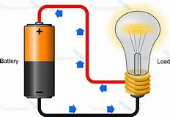
Electron Movement in a Circuit
Current Flow:
Due to the convention that was established long ago, “current flow” is actually opposite the direction of electron movement
The positive side of the battery is positive because the atoms are lacking sufficient electrons (thus are less negative…). These types of atoms are known an “ions”
Electrons flow from the negative end of the battery (excess electrons) to the positive end of the battery.

Slide 10
Electron Movement in a Circuit
The battery provides an electrical field that pushes the electrons through the circuit and creates the electromagnetic waves that transmit the energy
Energy is transmitted along a wire due to the propagation of electromagnetic waves, not the movement of electrons
The electromagnetic waves in a circuit, move at 70% - 80% the speed of light. This is why a light across the room seems to turn on instantaneously when the switch is thrown
Electron motion (a.k.a. electron drift) is actually very slow and depends on the material in the conductor – less than 1 meter per hour in a typical simple DC circuit

Slide 11
Batteries Connected in Series
1.5 V
1.5 V
1.5 V
4.5 V
Connecting batteries in SERIES:
Increases the total voltage
Does not increase the amount of current that can be drawn
Does not increase the capacity (a.k.a. duration it will run a device)

Slide 12
Batteries Connected in Series
Connecting Batteries in Parallel:
Does not increase the voltage
Increases the amount of current that can be drawn
Increases the capacity (a.k.a. the length of time it will run a device)
1.5 V
1.5 V
1.5 V
1.5 V

Slide 13
Measuring Voltage in a Circuit
Switch
-
You must measure ACROSS the electrical potential in order to measure the voltage
The Multi-Meter must be set to VOLTS as well as the proper measurement range.
M
+

Slide 14
How Long will a Battery Last?
In general, the larger the physical size of the battery, the longer it will last
The life of a battery also depends on how much current is drawn by the circuit it is powering
Batteries typically have an Amp-Hour rating, but common consumer batteries typically don’t publish the data
The approximate amount of time a battery will last can be determined by dividing the Amp-Hour rating of the battery by the current draw
Batt Capacity 3 Amp-Hr
Duration = ------------------ = --------------- = 25 hrs
Current Draw 0.12 Amp

Slide 15
Questions ?

